Slide 1

3 Benefits of Going Keto

Slide 2

Going on a keto diet is one of the best ways to lose weight and take charge of your health.

Slide 3
Going on a keto diet is one of the best ways to lose weight and take charge of your health.
Because of how the keto diet forces your body to use fat for fuel instead of glucose, it is incredibly beneficial to your health.

Slide 4
In this tutorial, I'm going to give you the three top benefits of going keto.

Slide 5
In this tutorial, I'm going to give you the three top benefits of going keto.
Let's get started.

Slide 6
1. Weight Loss

Slide 7
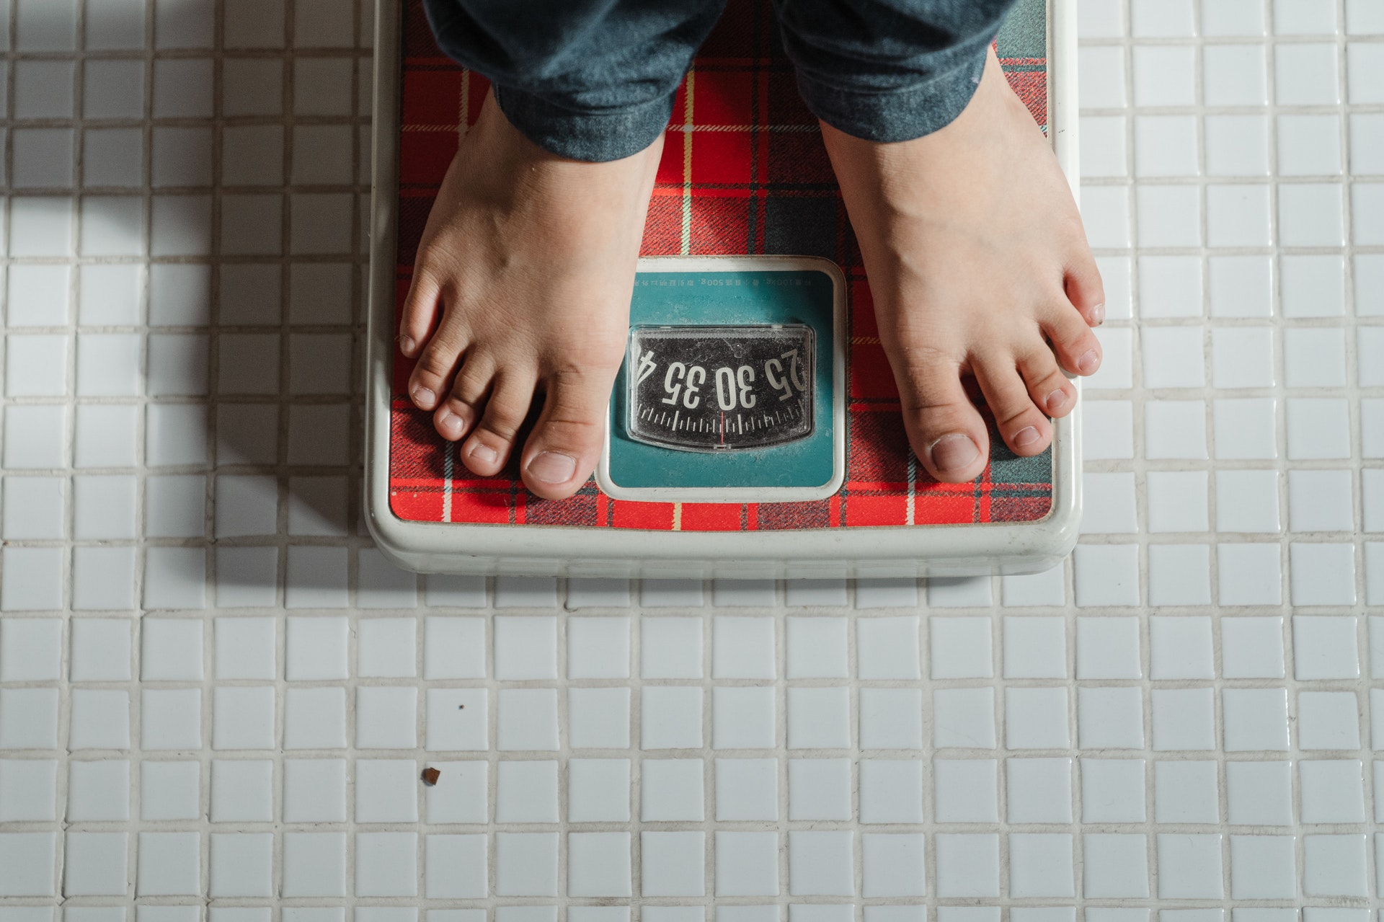

Slide 8
The keto diet leads to weight loss because it forces you to burn ketones, not glucose.

Slide 9
The keto diet leads to weight loss because it forces you to burn ketones, not glucose.
When you restrict your carbohydrate intake, your body is forced to use fat as your fuel.

Slide 10
The keto diet leads to weight loss because it forces you to burn ketones, not glucose.
When you restrict your carbohydrate intake, your body is forced to use fat as your fuel.
This means that you burn off fat for energy, allowing you to lose weight more easily.

Slide 11
That is why the keto diet is one of the best diets for weight loss.

Slide 12
That is why the keto diet is one of the best diets for weight loss.
However, you have to stick to the keto diet pretty seriously if you want to lose weight.

Slide 13
That is why the keto diet is one of the best diets for weight loss.
However, you have to stick to the keto diet pretty seriously if you want to lose weight.
You can't seesaw back and forth between your diet if you want to see any lasting results.

Slide 14
2. Reduces Blood Sugars
and Insulin Levels

Slide 15
The keto diet is especially helpful for those with diabetes or prediabetes.

Slide 16
Your body naturally runs off of glucose, which requires insulin as a transporter.

Slide 17
Your body naturally runs off of glucose, which requires insulin as a transporter.
When you run off the ketones, though, you have reduced blood sugars and insulin levels because they don't require insulin like glucose.

Slide 18
In fact, studies show that people with diabetes who take on a low carb diet typically reduce their insulin dosage by about 50%.

Slide 19
In fact, studies show that people with diabetes who take on a low carb diet typically reduce their insulin dosage by about 50%.
Even those with type 2 diabetes show a reduction in their glucose-lowering medication after going on a low carb diet.

Slide 20
3. Reduces Inflammation

Slide 21
Inflammation is your body's response to help you heal and fight against infection.

Slide 22
Inflammation is your body's response to help you heal and fight against infection.
Although inflammation is good when needed, chronic inflammation is painful and causes many negative side effects.

Slide 23
Inflammation is your body's response to help you heal and fight against infection.
Although inflammation is good when needed, chronic inflammation is painful and causes many negative side effects.
Pain, joint stiffness, swelling, and fatigue are just a few examples of chronic inflammation symptoms.

Slide 24
When you are in a regular state of ketosis, your body produces ketones.

Slide 25
When you are in a regular state of ketosis, your body produces ketones.
Ketones are a natural anti-inflammatory chemical.

Slide 26
When you are in a regular state of ketosis, your body produces ketones.
Ketones are a natural anti-inflammatory chemical.
As a result, the ketones reduce inflammation in your body.

Slide 27
When you are in a regular state of ketosis, your body produces ketones.
Ketones are a natural anti-inflammatory chemical.
As a result, the ketones reduce inflammation in your body.
More than this, the food that you eat while on a keto diet tends to be anti-inflammatory, as well.

Slide 28


Slide 29
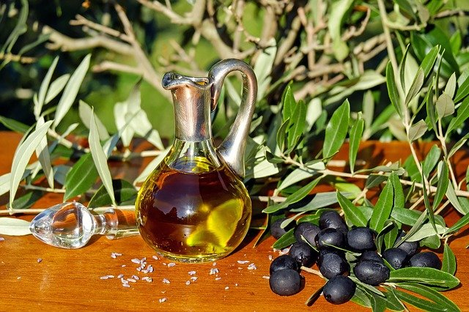

Slide 30
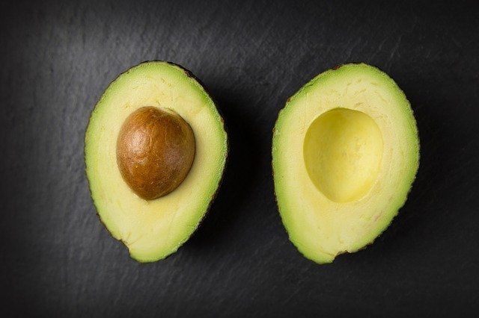

Slide 31
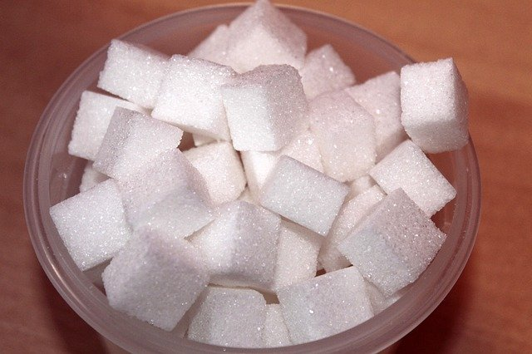

Slide 32
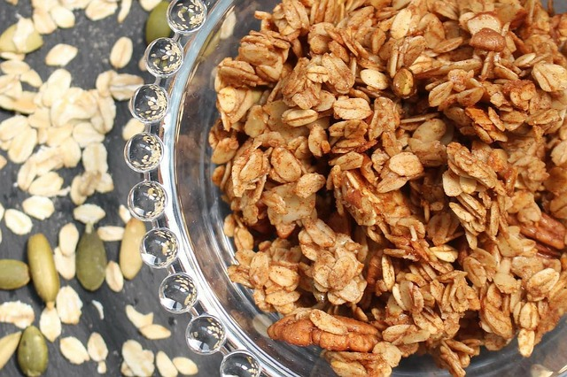

Slide 33
Final Thoughts

Slide 34
Going keto is a great way to take advantage of your health and make the most of your life.

Slide 35
Going keto is a great way to take advantage of your health and make the most of your life.
You can expect to lose weight, experience a reduction in blood sugars and insulin levels, and experience a reduction in inflammation.

Slide 36
Going keto is a great way to take advantage of your health and make the most of your life.
You can expect to lose weight, experience a reduction in blood sugars and insulin levels, and experience a reduction in inflammation.
Although these are not all of the keto diet benefits, they are some of the most important.

